Slide 1
Flipped Classroom
A aula do avesso
Pedro L. Fernandes
Instituto Gulbenkian de Ciência
Oeiras, Portugal
Notes:
<number>

Slide 2
<number>
Outline
What is Flipped classroom ?
Flipped classroom as a learning technique
- original idea
- major results
- towards mastery
- flipped classroom in higher education
Flipped classroom implementation requirements
Mixing Flipped classroom with other techniques
Using Flipped Classroom in a Medical School example
- discussion of clinical cases
Flipped classroom FMUL
11/23/2016

Slide 3
<number>
Flipped classroom is
A pedagogical model aimed at increasing interaction between students and teachers.
Consists of swapping activities between classroom and elsewhere (home).
The teacher is no longer the “sage on the stage” and becomes the “guide on the side”.
Materials made available upfront:
Readings + Recorded Lectures + Reference Documents
Flipped classroom FMUL
11/23/2016

Slide 4
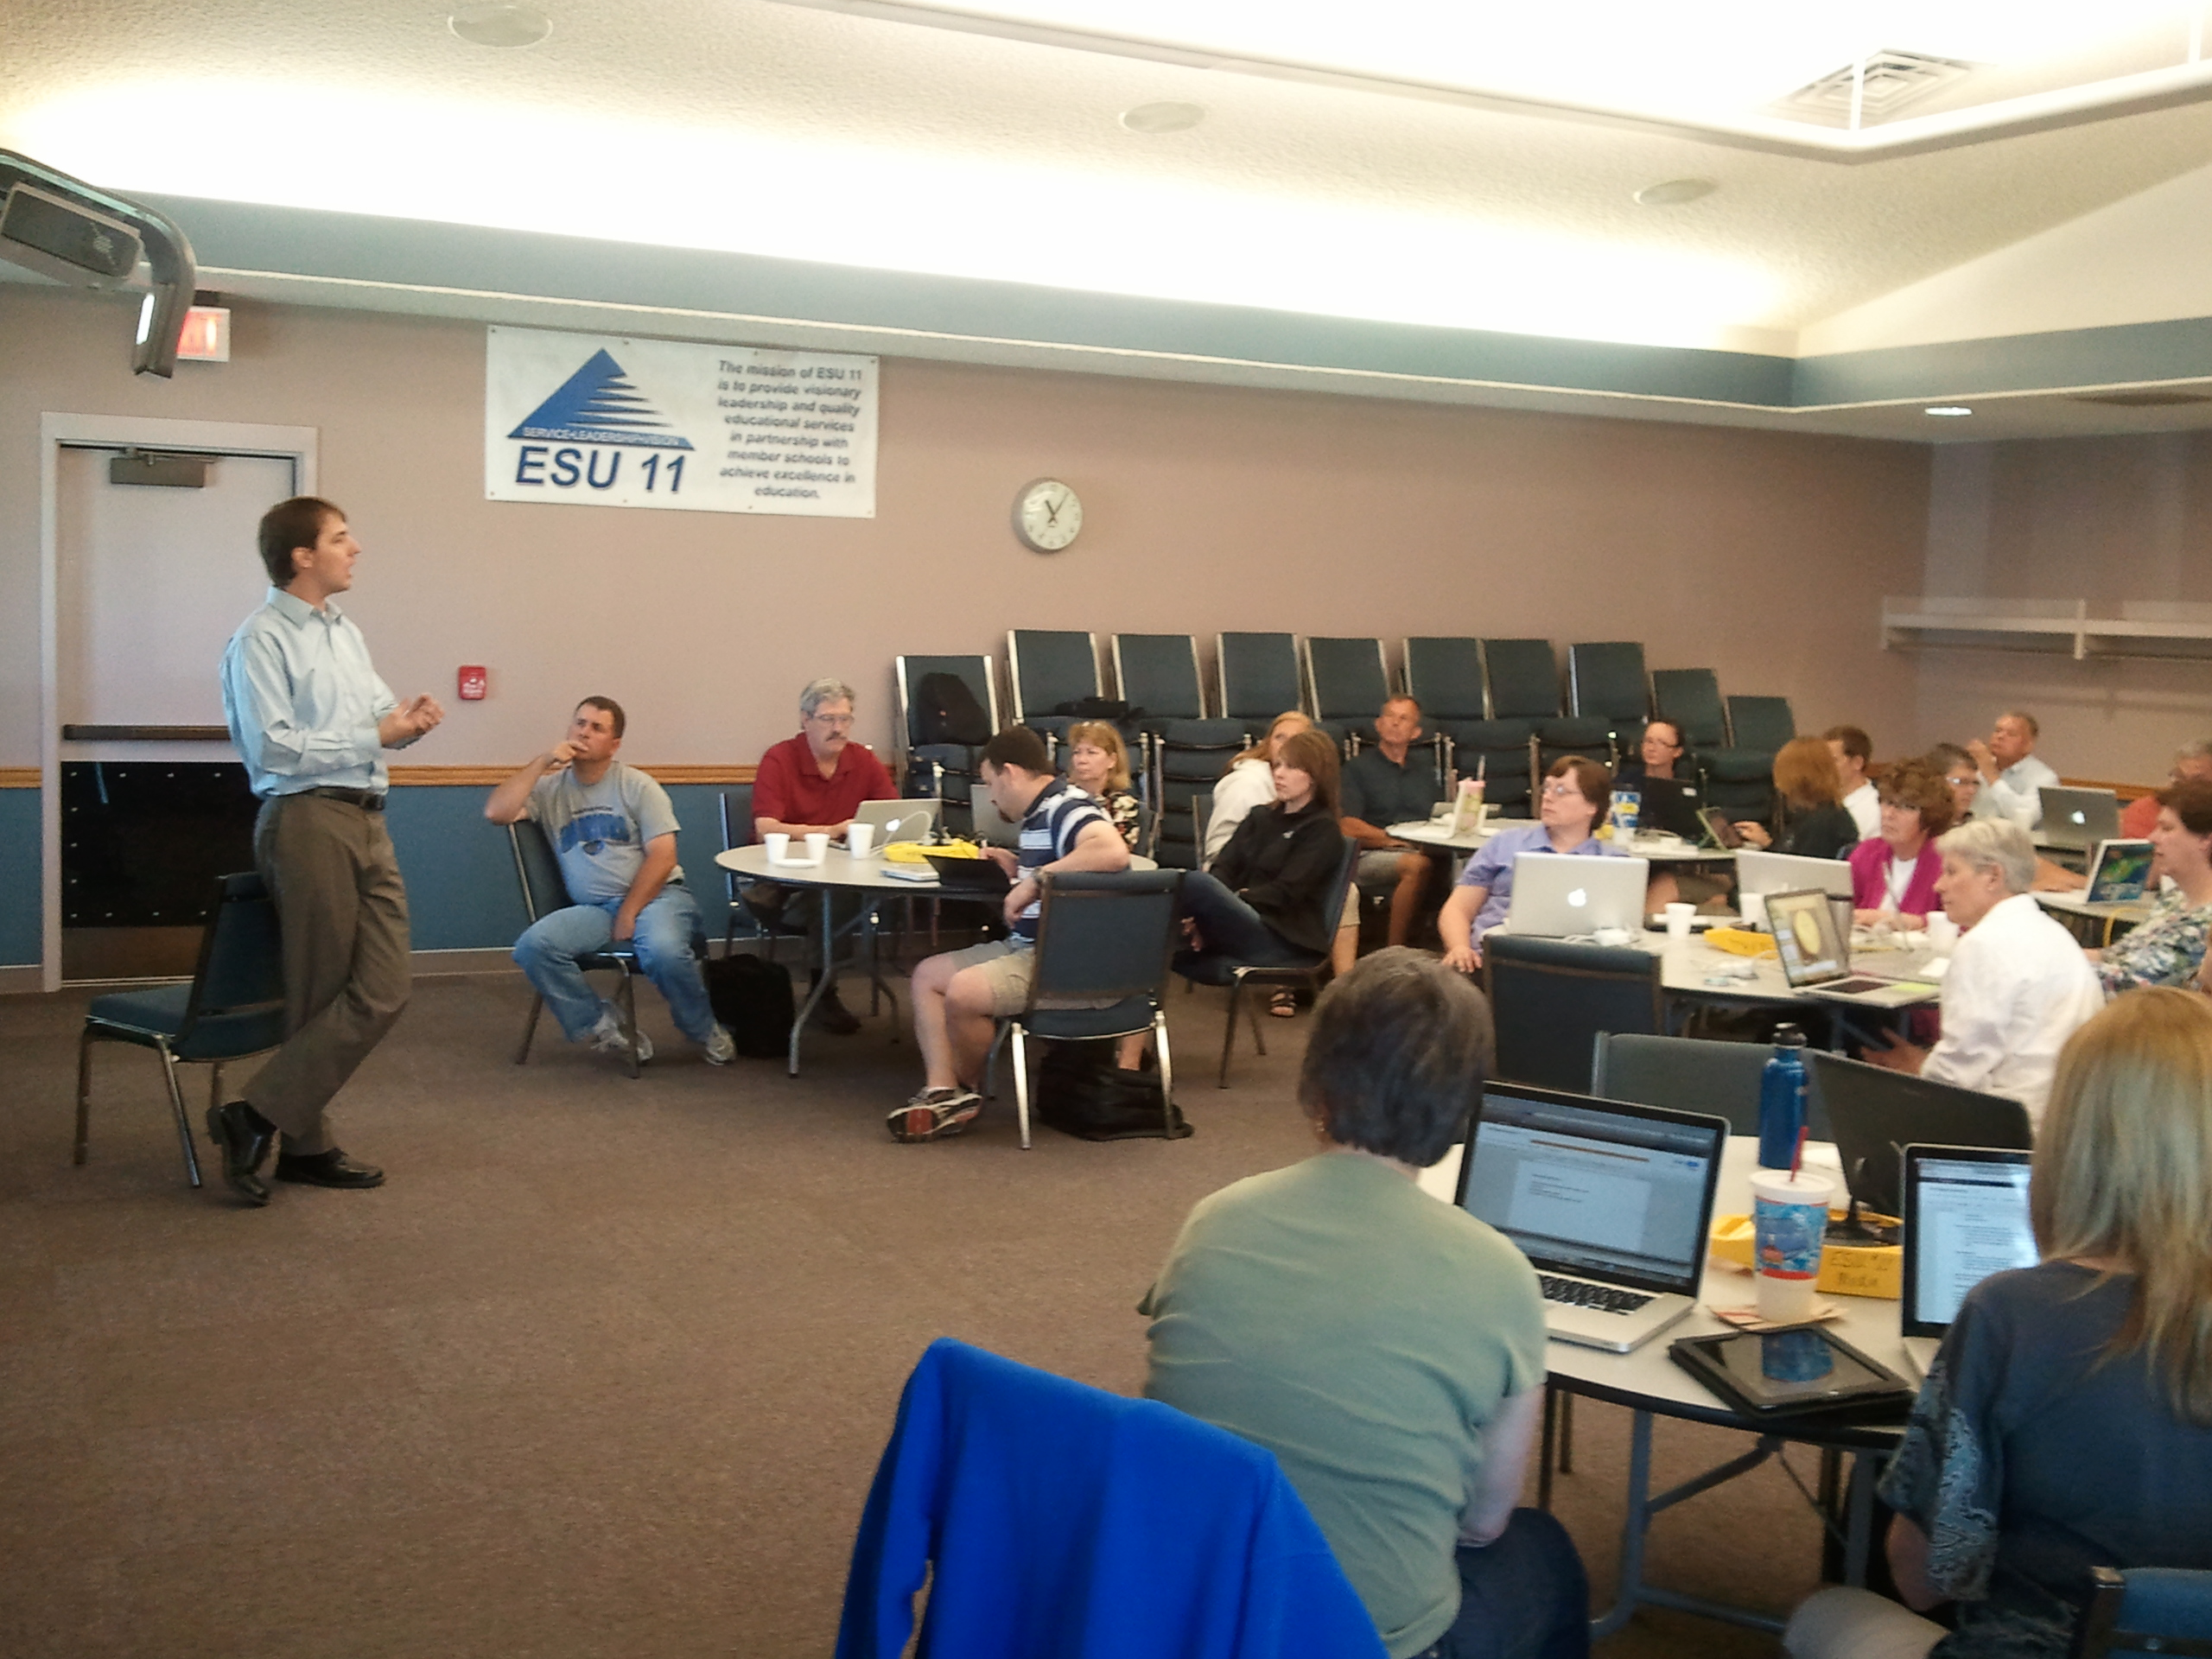
<number>
Flipped classroom is
Flipped classroom models utilise existing learning concepts such as:
- Active learning
- Student motivation
- Student engagement
- Hybrid course design
Flipped classroom FMUL
11/23/2016
Notes:
<number>

Slide 5
<number>
In a Flipped classroom model
Classroom time is interaction time.
- Instructional support: teacher-guided group or lab work
- Deepening knowledge: discussions and illustrations of the concepts.
- Instant feedback. Providing individual attention becomes possible.
- Review activities, enabling students to develop critical thinking.
Flipped classroom FMUL
11/23/2016

Slide 6
<number>
What a good Flipped classroom leads to
With the increased level of individual attention, students feel more motivated and engaged by taking leading roles in the classroom activities.
This shift in attitude pushes students towards higher levels of responsibility in the learning process.
Flipped classroom FMUL
11/23/2016
Notes:
<number>

Slide 7
<number>
What Flipped classroom is NOT
Watching videos of long lectures.
Replacing teachers with videos.
Online course delivery.
Students working without structure.
Students using computers all the time.
Students working in isolation.
Flipped classroom FMUL
11/23/2016

Slide 8
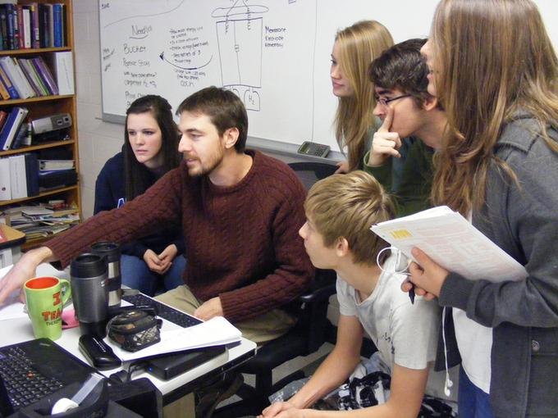
<number>
Original idea
2007-2008 Bergmann and Sams in a high school in Colorado
The criticality of scheduled lectures
Teaching is not taylored to students (personalised)
There is no reason not to supply materials in advance
Priority needs to be given to discussions around
concepts
Flipped classroom FMUL
11/23/2016

Slide 9
<number>
Major results
Measured improvements in
learning outcomes
student satisfaction
use of school resources
scalability of learning delivery
Flipped classroom FMUL
11/23/2016

Slide 10
<number>
Towards Learning Mastery
In a flipped classroom, 5 steps, ensuring that the student has learned
Direct instruction
Practice
Going Deeper
Assess
Remediate
< 75%
Adapted from Bergmann, 2016
http://www.jonbergmann.com
Flipped classroom FMUL
11/23/2016

Slide 11
<number>
Flipped Classroom in Higher Education
Flipped Classroom is directly usable in higher education.
If carefully implemented, it may even be easier (teaching adults).
Specific teaching skills are required (training of teachers), along with correct choices in technology, adoption of common methods, etc.
Guidance, pilot experiments and gradual adoption are advisable.
Flipped classroom FMUL
11/23/2016

Slide 12
<number>
Flipped classroom requirements
Class size – works best with small groups (<25)
Materials – adoption of rules for their production, uniformity, access
Readiness of instructors – training is required. Propagation within a school.
Design steps that may be difficult
Breaking down the subject matter in bite sized chunks
Incorporating and using assessment
Matching institutional requirements (conformance)
Flipped classroom FMUL
11/23/2016

Slide 13
<number>
Mixing Flipped classroom with other techniques
Distance learning
Can extend the classroom beyond its physical limits, virtual classroom using audio/video.
e-learning
Interactive tools that can provide the practice component, enabling further “in-class” discussion.
Instant feedback
Learning Catalytics, Socrative, clickers, no technology voting
Flipped classroom FMUL
11/23/2016

Slide 14
<number>
Flipped classroom in a Medical School
Example from Porto (FMUP) – Bases Cuidados Geriátricos
(Mixed model with distance learning, typical <20 in class, 100 remote)
Together with a pre-class reading, a pool of clinical cases is made available in the LMS (Moodle) ahead of the class time. Students can pick the cases and volunteer to present them (or be assigned).
From Geriatrics Review Syllabus (8th ed.)American Geriatrics Society)
A session with a hosted video conference (Adobe Connect). A a live lecture is transmitted, followed by clinical case presentations (15 min) and a group discussion. Instant feedback.
Flipped classroom FMUL
11/23/2016

Slide 15
<number>
Final remarks
The Flipped Classroom model can be gradually adopted in higher education
Care should be taken to run pilot experiments first, under adequate guidance
Flawless technical support is needed
A project leading to a pedagogical program is needed
Flipped classroom FMUL
11/23/2016

Slide 16
<number>
Web Resources
Vanderbilt University Center for Teaching
https://cft.vanderbilt.edu/guides-sub-pages/flipping-the-classroom/
Stanford Medicine Interactive Initiatives: Interactive Learning
http://smili.stanford.edu/interactive-learning/faq.html
Flipped Learning Network (with how-to’s)
http://flippedlearning.org/
Educause Learning Initiative (PDF)
7 things you should know about Flipped Classrooms
http://net.educause.edu/ir/library/pdf/ELI7081.pdf
Jonathan Bergmann’s website http://www.jonbergmann.com
Flipped classroom FMUL
11/23/2016

Slide 17

<number>
Reference Book
Flip your Classroom
Reach every student in every class every day
by Jonathan Bergmann and Aaron Sams
International Society for Technology in Education (Eds.) 2012
ISBN 978-1-56484-351-9
Flipped classroom FMUL
11/23/2016

Slide 18
<number>
Recent papers
Moraros, J., Islam, A., Yu, S., Banow, R., & Schindelka, B. (2015). Flipping for success: evaluating the effectiveness of a novel teaching approach in a graduate level setting. BMC Medical Education, 15, 27. http://doi.org/10.1186/s12909-015-0317-2
Williams, D. E. (2016). The Future of Medical Education: Flipping the Classroom and Education Technology. The Ochsner Journal, 16(1), 14–15.
Sarah McLean, Stefanie M. Attardi, Lisa Faden, Mark Goldszmidt
Advances in Physiology Education Published 1 March 2016 Vol. 40 no. 1, 47-55 DOI: 10.1152/advan.00098.2015
Flipped classroom FMUL
11/23/2016

Slide 19
<number>
Acknowledgements
Discussions:
Ovidio Costa (FMUP, Porto, PT)
Allegra Via (U. Roma, “Sapienza”, Roma, IT)
Mário Macedo (U. Atlântica, Barcarena, PT)
Kristian Rother (Academis, Berlin, DE)
Arnaldo Costeira (ESTAL, Lisboa, PT)
Support:
Instituto Gulbenkian de Ciência (IGC, Oeiras, PT)
Faculdade de Medicina da Universidade do Porto (FMUP, Porto, PT)
Flipped classroom FMUL
11/23/2016

